Slide 1
OSMCtrl – An open source Windows application for OpenStreetMap
PJ Naughter
UL Transaction Security
Microsoft MVP in Visual Studio and Development Technologies
Dublin C/C++ Users Group Presentation (5 March 2018)

Slide 2
Talk Outline
About me
OpenStreetMap (OSM)
Website / data examples
Tiles
OSMCtrl
General Features
Handling tiles
GUI features
Misc Features
Further Information

Slide 3
About me
Work as a senior C++ developer with UL Transaction Security (https://www.ul-ts.com/) in Dublin. Our main product is called ASTREX and provides a Windows based EMV testing and validation platform for the Financial and Banking industry
Been a Microsoft C++ MVP since 2007
Publish open source software at www.naughter.com. Just over 500,000 lines of source code on my web site

Slide 4
OpenStreetMap (OSM)
www.openstreetmap.org An Open Source collaborative project to create a free editable map of the world. Started in 2004 in London and inspired by the success of Wikipedia
The building blocks of OSM data are ways, nodes and relations
The canonical representation of OSM data is via an XML schema but tools are available to import the data into databases to make manipulating the data easier
As of February 2018, OSM currently contains over 4 billion nodes, 471 million ways, 5 million relations, 50 thousand active contributors and 4.7 million contributors in total
A full dump of the OSM data for the whole world as XML is currently 97GB in size while a protocol buffers version is 63 GB in size (https://planet.openstreetmap.org/planet/full-history/)
Many other Open Source projects are in the OSM stack or use data from it. Examples include: iD, JOSM, Mapnik, Merkaartor, Nominatim, Overpass turbo, Leaflet, Osm2pgsql, OsmAnd & Maps.me
It is also used extensively in developing countries where there are no commercial or governmental mapping agencies. Irish OSM members have been actively mapping the African country of Lesotho over the last few years
Irish OSM members have mapped all the 60,000+ townlands in Ireland (http://maps.openstreetmap.ie/ and https://www.townlands.ie/)
Also used during humanitarian emergencies. e.g. 2010 Haiti Earthquake, 2015 Nepal Earthquake & 2017 Ebola outbreak

Slide 5
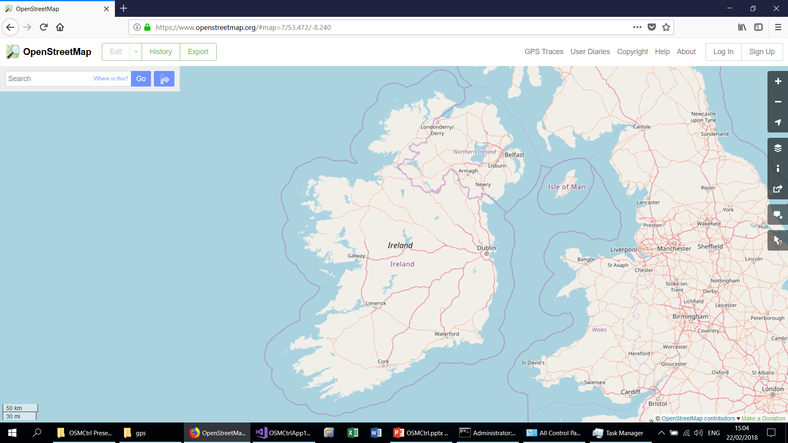
OSM Web Site (Ireland)

Slide 6
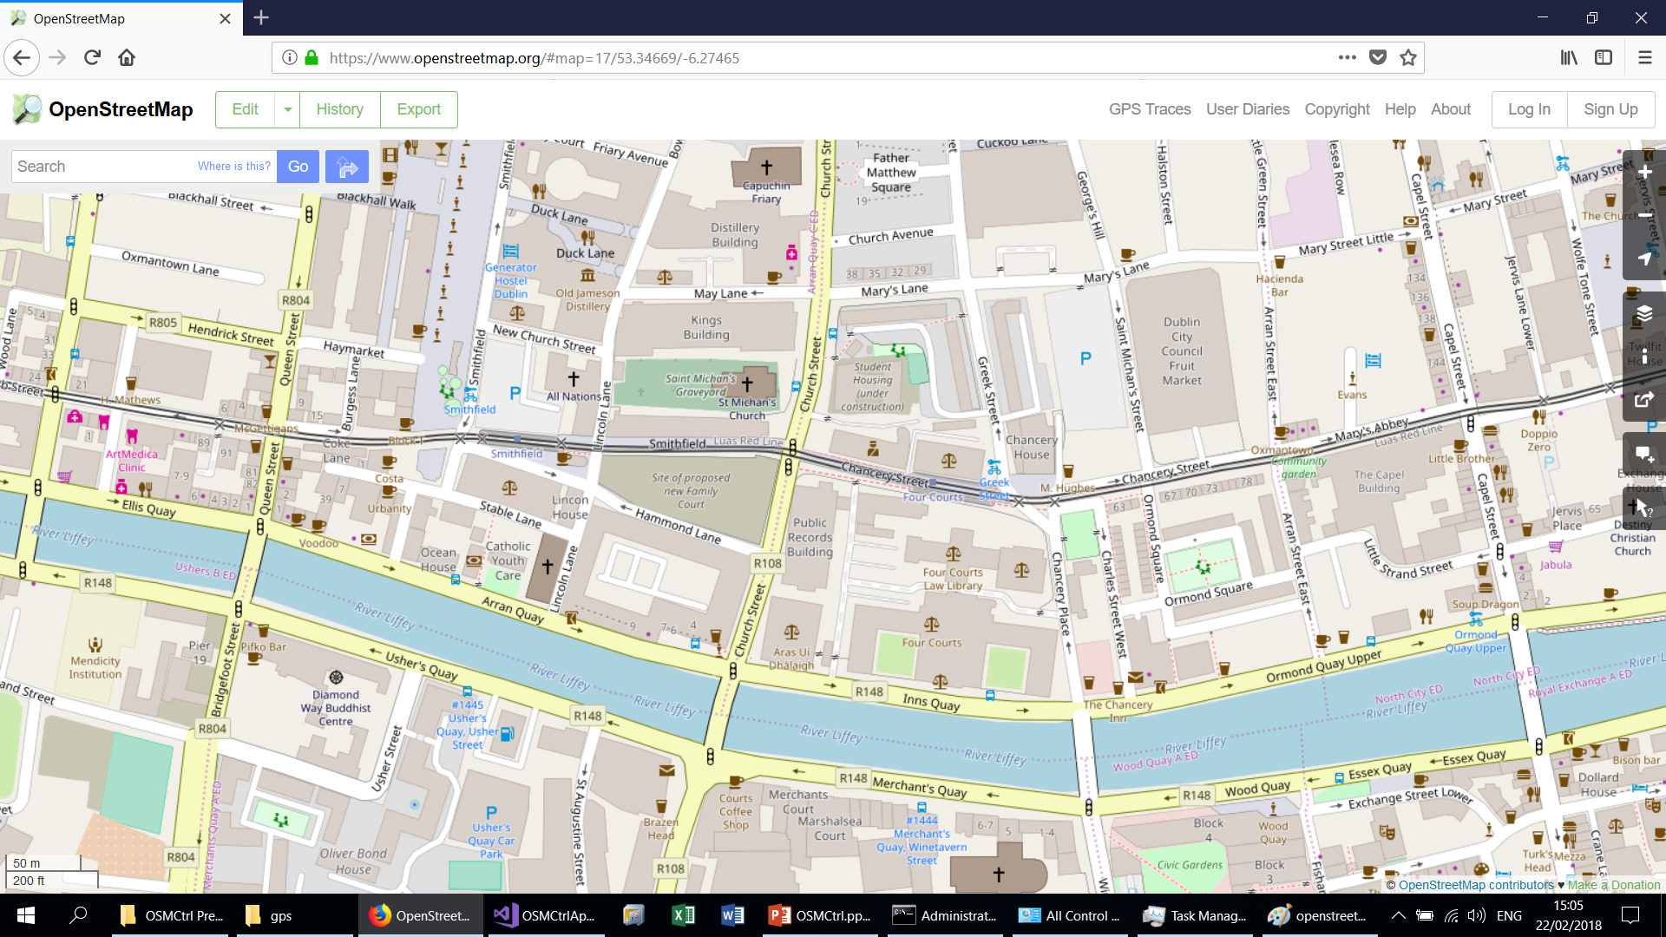
OSM Web Site (Dublin)

Slide 7
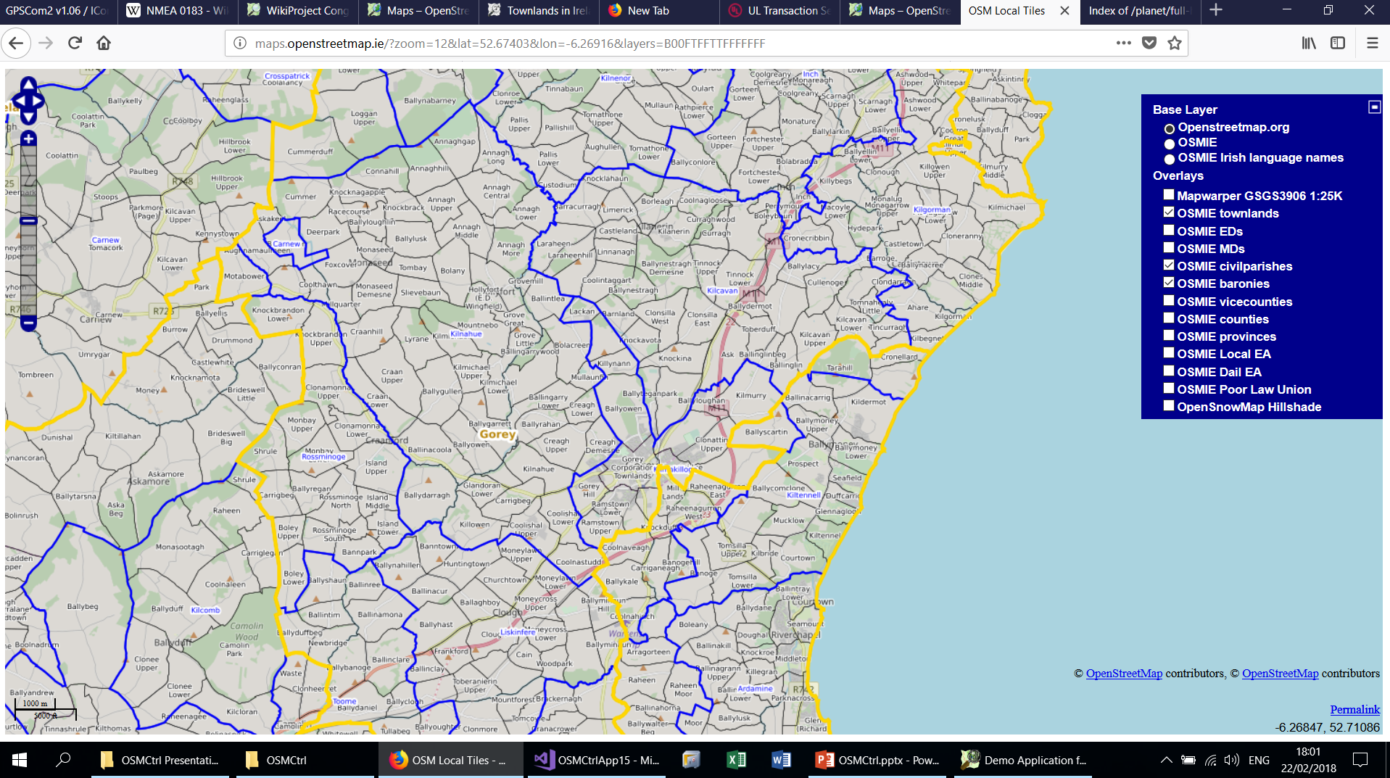
Baronies, Civil Parishes & EDs in North Wexford

Slide 8
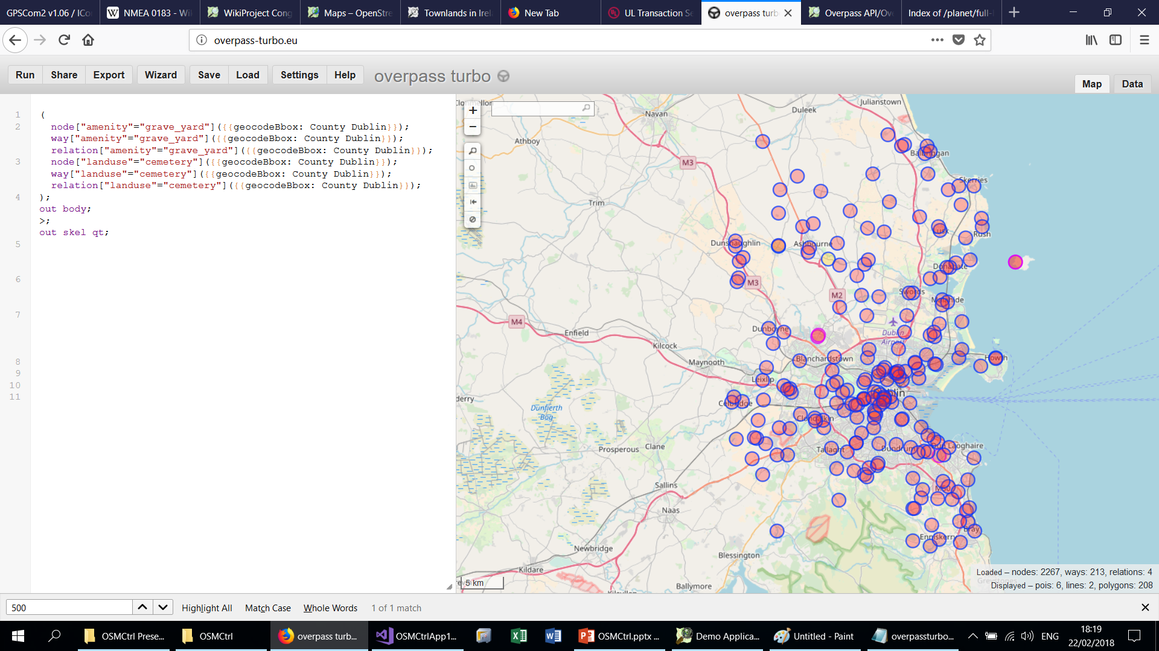
All Graveyards and Cemeteries in County Dublin

Slide 9
OSM Tiles
OpenStreetMap.org and many commercial OSM providers provide a “Slippy map” interface for building web based or client maps. This is based on the concept of a tile which is a rendering of a certain subset of your map e.g. http//tile.openstreetmap.org/”Zoom Value”/”X Value”/”Y Value”.png. Inspired by the original implementation on Google Maps
Implemented using a PostGIS enabled ProgreSQL database with Osm2pgsql tool. Rendering implemented using Mapnik
At zoom level 0, you have one 256 * 256 png image which covers the whole world (360 degrees of longitude and c. 85° South to 85° North of the equator)
At each increasing zoom level you have 4 times as much tiles as at the previous zoom level.
At zoom level 18, you have roughly 68 billion tiles in total with each tile being roughly 100 meters on each side at the latitude of Ireland.
Algorithm to convert from Lat / Long to and from the X and Y values supported by COSMCtrlHelper class
At higher zoom levels, OpenStreetMap will render tiles on request while at lower zoom levels, tiles will pre rendered

Slide 10
OSMCtrl (General Features)
An Open Source Windows application developed in MFC (VC 2013 or later) for displaying OpenStreetMap tiles (supports x64 and x86)
Basic class is COSMCtrl. Derived from the MFC class CStatic
Supports native Windows GPS Sensors via http://www.naughter.com/mfcsensor.html
Supports standard NMEA 0183 GPS devices via http://www.naughter.com/gpscom2.html. Roughly equivalent to gpsd on Windows
Supports collecting, importing and display of GPX files via CGPXWaypoint, CGPXTrackSegment, CGPXTrack & CGPX classes using MSXML6
Uses Windows Animation APIs when zooming in or out or rotating the map (IUIAnimation* COM interfaces)
Supports Nominatim search and reverse geocoding queries (http://www.naughter.com/nominatim.html) e.g. “Pubs in Gorey” or converting a Latitude / Long location into an Address
Uses Vincenty’s Algorithm (https://en.wikipedia.org/wiki/Vincenty%27s_formulae) to calculate accurate distances and bearings between points on the Earth’s surface. (COSMCtrlHelper class)

Slide 11
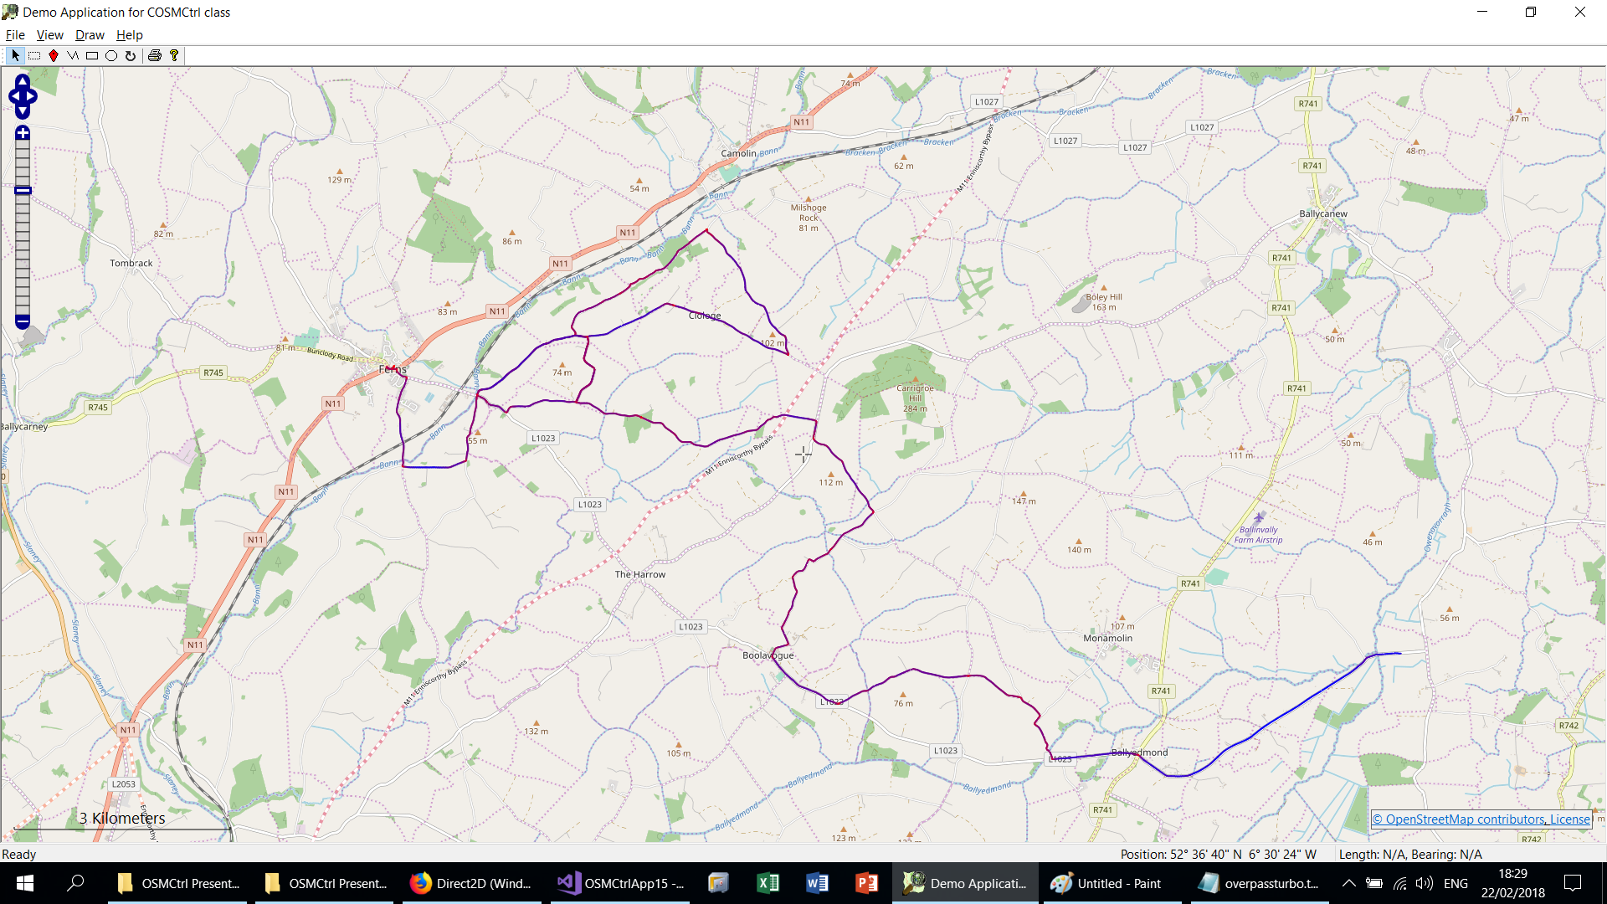
OSMCtrl (GPX overlay)

Slide 12
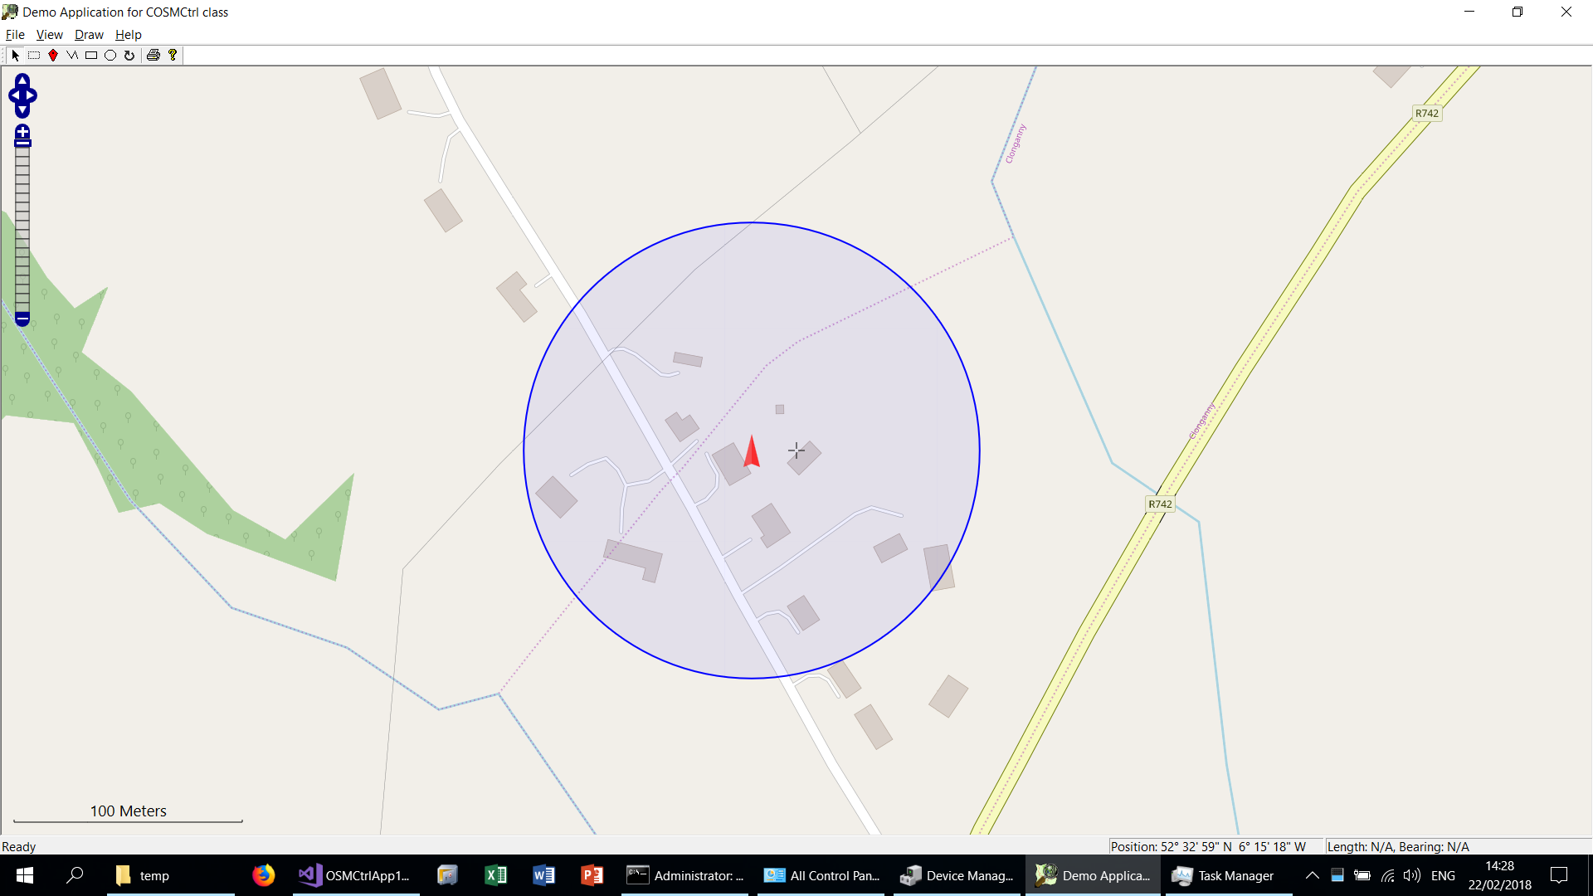
OSMCtrl (NMEA GPS)

Slide 13
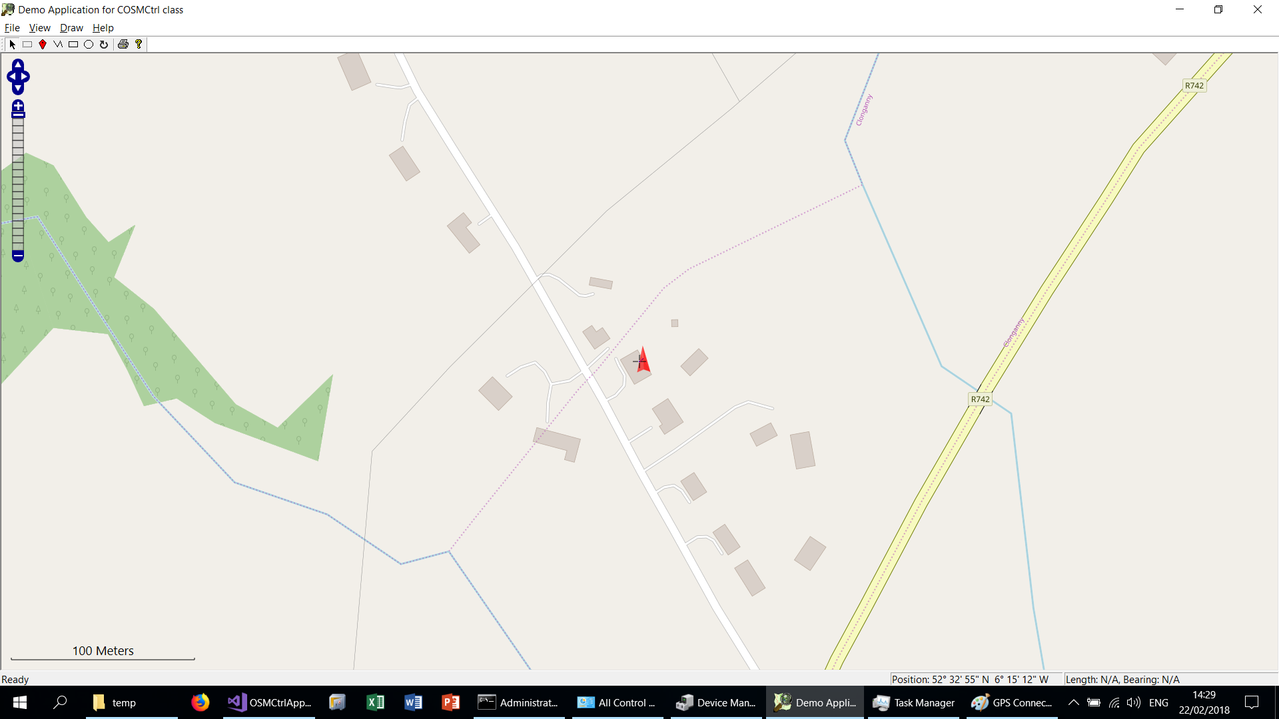
OSMCtrl (Windows GPS Sensor)

Slide 14
OSMCtrl (Handling Tiles)
Supports asynchronous downloading of tiles via WinHTTP (http://www.naughter.com/winhttpwrappers.html). Roughly equivalent to libcurl on Windows. Uses a cancellable worker thread to perform the background downloads. If you were doing this in HTML you could use something like the JavaScript Leaflet library
Supports Mapnik & Cyclemap tile providers out of the box. Can easily add others using a IOSMCtrlTileProvider interface class
Uses GDI / GDI+ or Direct2D for the drawing of tiles. D2D is the hardware accelerated 2D drawing API available on Windows. Now used by MS Edge, Chrome and Firefox to do their UI composition on Windows. It provides a subpixel floating point coordinate space and is exposed as a COM API. For those familiar with GDI / GDI+ most objects types (lines, pens, fills, strokes, transforms, bitmaps etc) have equivalents. MFC provides C++ wrappers for these COM objects to make coding easier. These objects are internally implemented as 3D objects in Direct3D and logically reside on your graphics card. My Ad-hoc perf testing showed a 900% speed increase in full screen draws in OSMCtrl when using D2D compared to GDI+

Slide 15
OSMCtrl (GUI Features)
Supports zooming via keyboard keys and the wheel mouse. It uses the keys '+' and '-' and a mouse left double click
Supports scrolling via the keyboard as well as mouse dragging. It uses the keys "Left", "Back", "Right", "End", "Up", "Prior", "Down" and "Next"
Supports a scroll rose and zoom bar based on the same controls on the OpenStreeMap web site
Supports displaying a simple legend which indicates scale
Support for drawing crosshairs at the centre of the map
Supports automatically displaying correct OpenStreetMap copyright attribution on the control. This is achieved through the use of a child control SysLink control with hyperlinks to the OpenStreetMap web site and the license it uses (CLinkCtrl MFC class).
All of the control parts which the COSMCtrl class supports namely scroll rose, zoom bar, legend and the copyright items can be attached to specific client locations on the map
Tiles from the previous and next zoom level can be used in a stretched and squeezed fashion if not available at the current zoom level
Supports used defined markers, polylines, polygons and circles being overlaid on the map. Also supports interactive editing, dragging, moving and deleted these items.
Tiles outside the visible edge can be pre-cached for improved performance
Providers hit testing and a Rectangular selection mode. When this mode is activated, you can select specific markers, polylines and polygons on the map and in conjunction with support for the "Delete" button you can interactively edit the items on the map

Slide 16
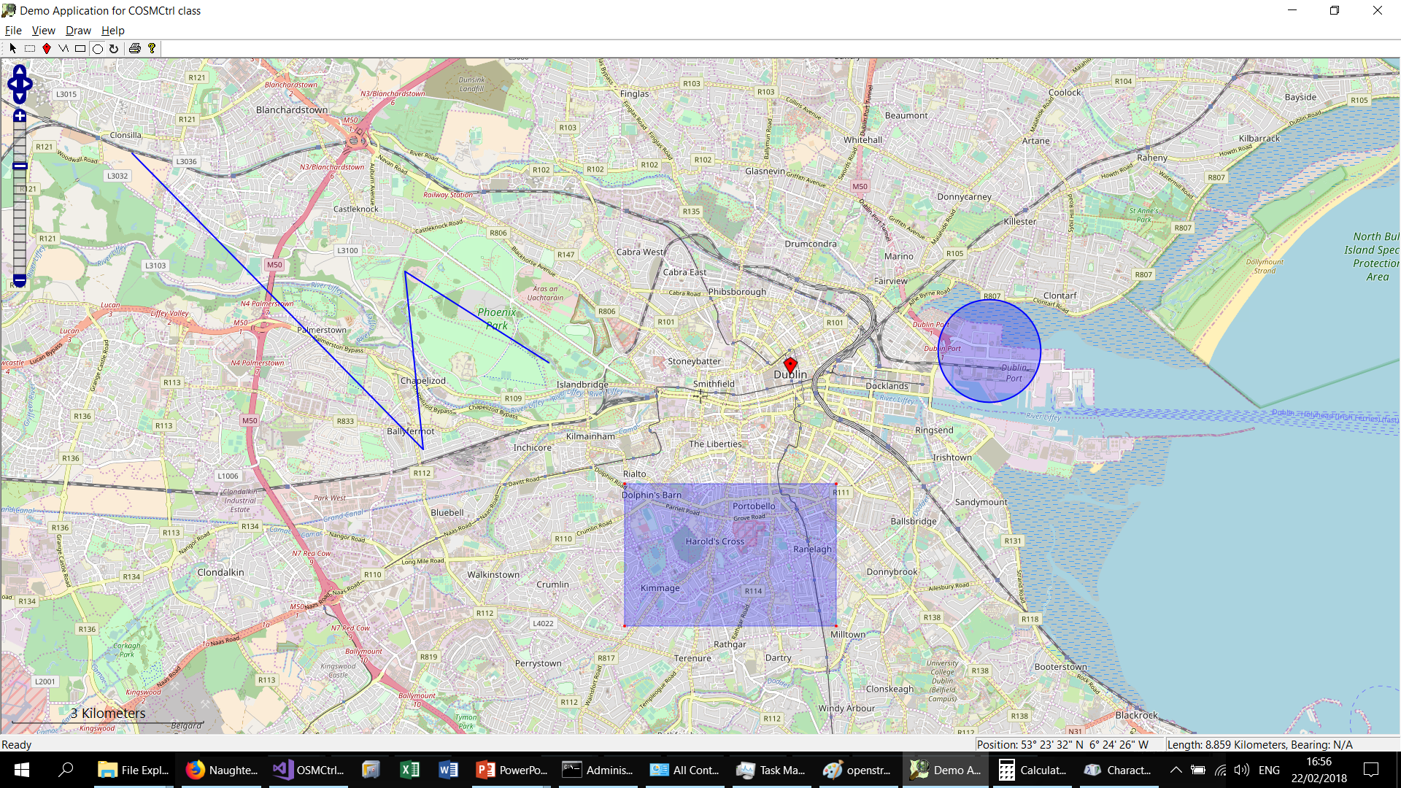
OSMCtrl (Polygons, Polylines, Rectanges, Markers and Circles)

Slide 17
OSMCtrl (Misc. Features)
Integrates with the MFC document / View architecture to provide full print preview and print support.
Supports a comprehensive "Map Operations" dialog. This allows you to delete specific tiles, download specific tiles (optionally skipping files which have already been downloaded) as well as support Mapnik re-render requests.
Supports "decimation" of polylines and polygons. This feature adds new nodes between all the existing nodes of a polyline or polygon. This can prove useful where you have a feature where the curvature of the earth can cause distortion of the displayed object. By default this feature is provided for by double clicking on an editable polyline or polygon.
Supports a ZoomToBounds method. This method takes two positions which the method will ensure will be shown on the map at the highest possible zoom level. In conjunction with various "GetBoundingRect*" methods you can now add your various items to the map and then zoom to those items. This avoids client code needing to explicitly handle zoom levels of centre positions.
Supports changing the map orientation so that north is not necessarily at the top of the mode. Can be used for a follow me mode when capturing live GPS data.
Provides a simple measure features between points on the map

Slide 18
Further Information
OpenStreetMap https://ww.openstreetmap.org
Irish OSM https://www.openstreetmap.ie/
Slippy Maps https://wiki.openstreetmap.org/wiki/Slippy_map_tilenames
Nominatim https://nominatim.openstreetmap.org
Overpass turbo https://overpass-turbo.eu
JOSM https://josm.openstreetmap.de
GPX file format http://www.topografix.com/gpx.asp
NMEA thttps://en.wikipedia.org/wiki/NMEA_0183
Direct2D https://msdn.microsoft.com/en-us/library/windows/desktop/dd370990(v=vs.85).aspx
Website http://ww.naughter.com
Work email pj.naughter@ul.com
Personal email pjna@naughter.com
Blog https://naughter.wordpress.com
Twitter https://twitter.com/PJNaughter

